Slide 1
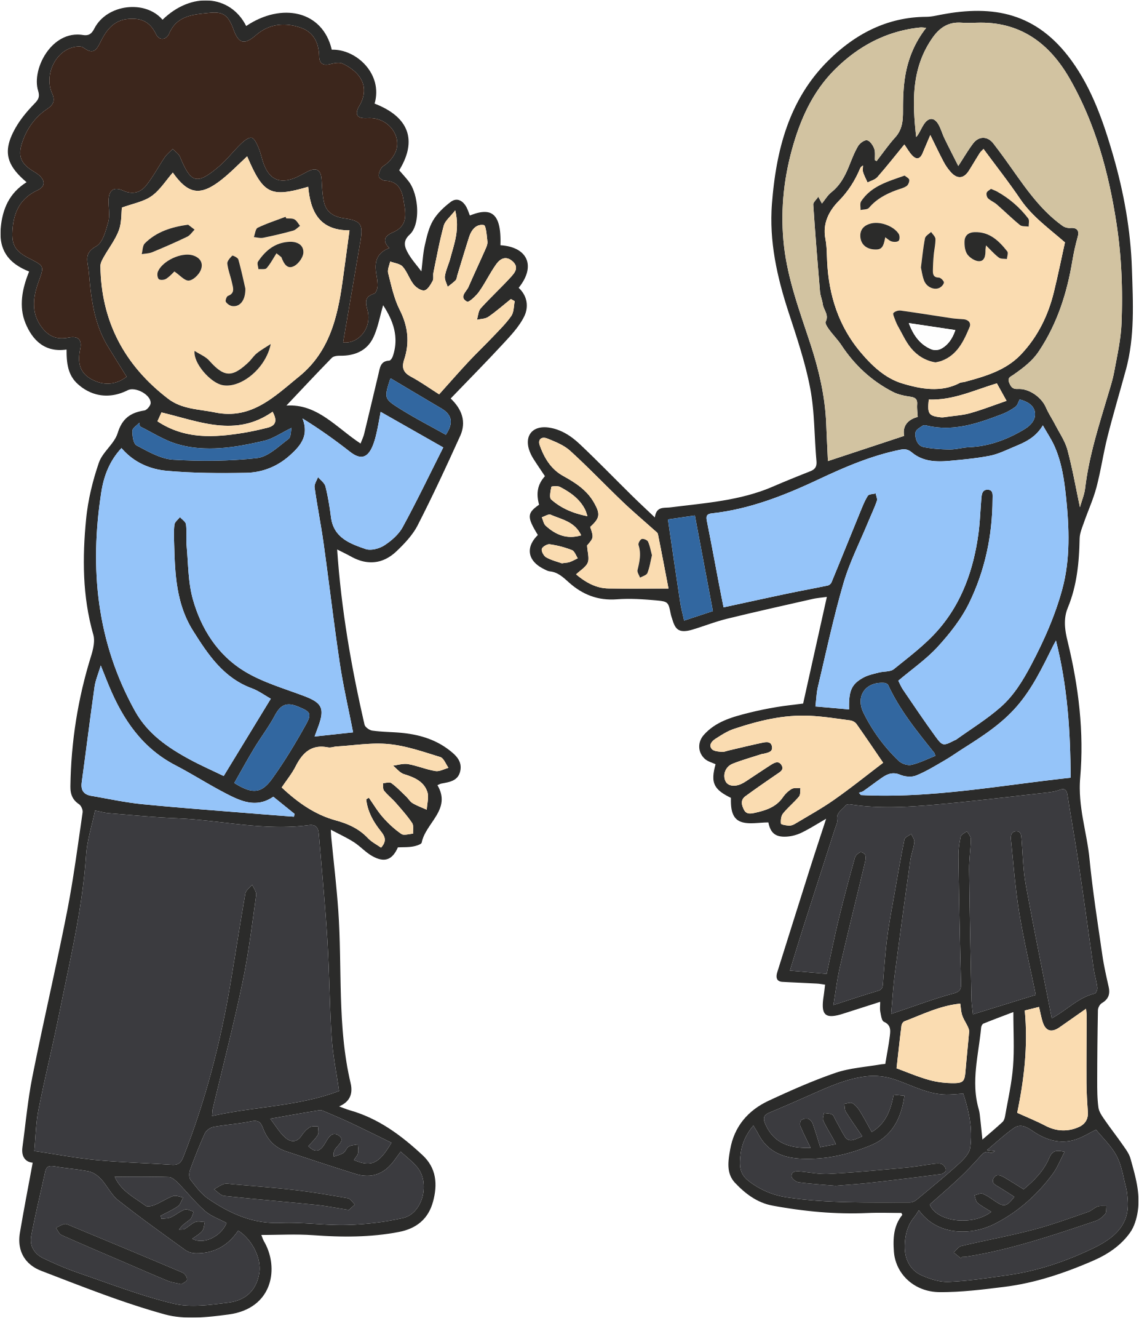
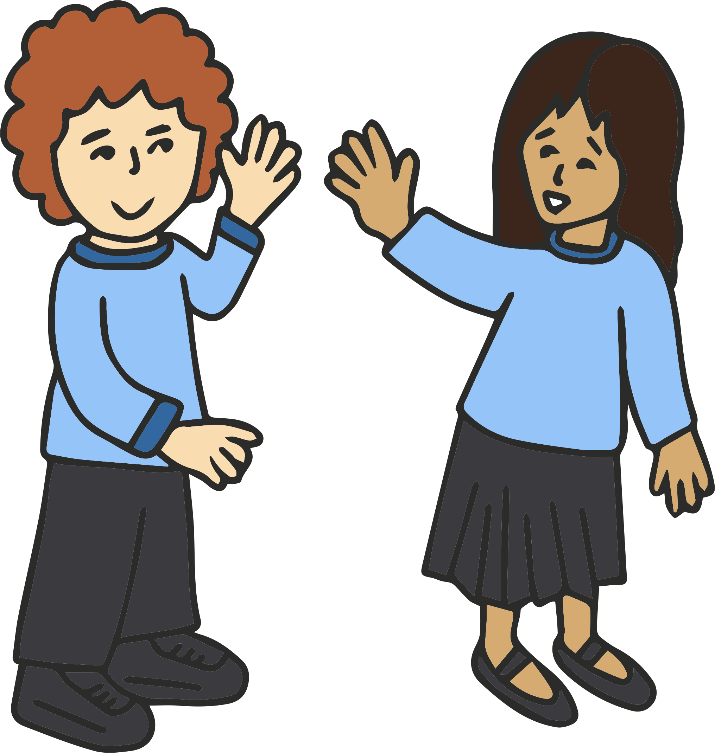
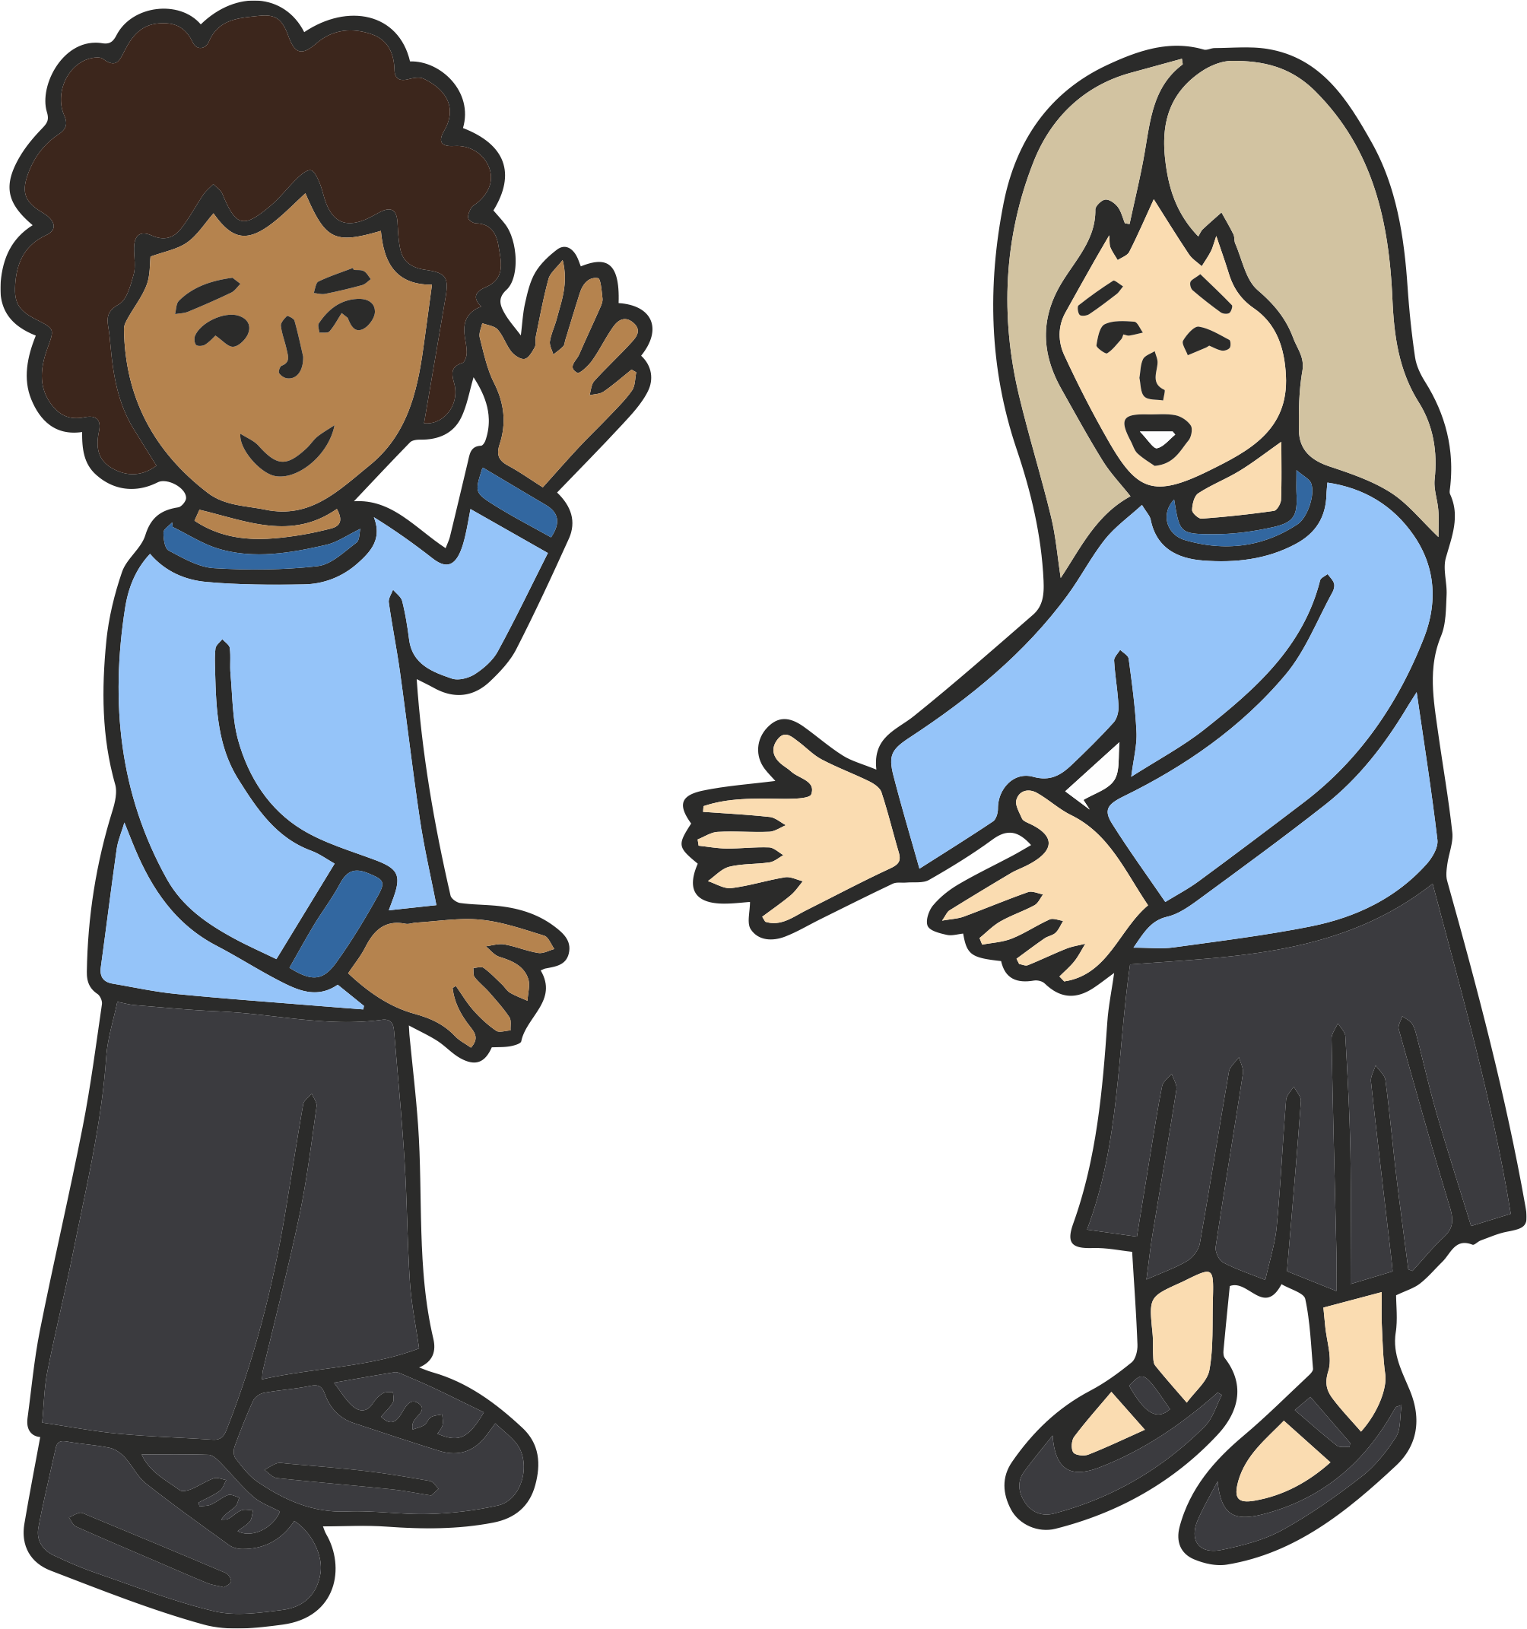
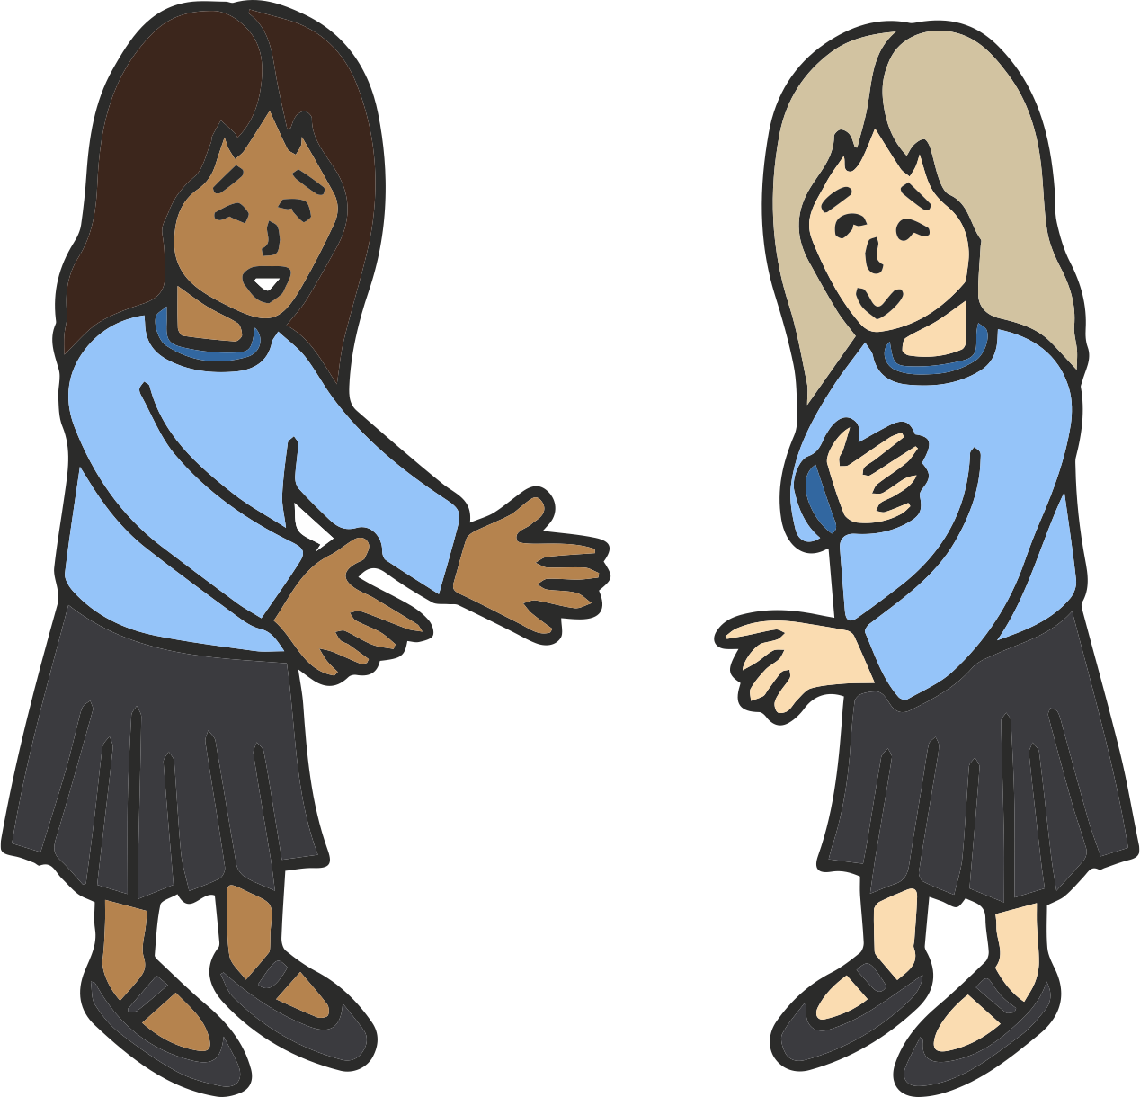
Year 3 - Greetings
Salut !
Bonjour !
Au revoir !
Au revoir !
1
2
3
4
Comment tu t’appelles ?
Je m’appelle Celine
Bonsoir ! Ça va ?
Bonsoir ! Oui, Ça va très bien !
5
6
7
8
1
Which two people are saying hello to each other?
_______________________________________________________________________
_______________________________________________________________________

Slide 2
Year 3 - Greetings
2
Which two people are introducing themselves? Copy the dialogue underneath.
_______________________________________________________________________
_______________________________________________________________________
_______________________________________________________________________
_______________________________________________________________________
3
Which two people are asking about how they are feeling? Copy the dialogue underneath.
_______________________________________________________________________
_______________________________________________________________________
_______________________________________________________________________
_______________________________________________________________________

